Slide 1
Natural Language Processing

Slide 2
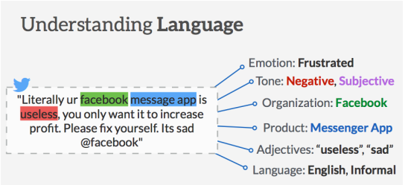
Introduction
Humans communicate with each other using words and text. The way that humans convey information to each other is called Natural Language. Every day humans share a large quality of information with each other in various languages as speech or text.
However, computers cannot interpret this data, which is in natural language, as they communicate in 1s and 0s. The data produced is precious and can offer valuable insights. Hence, you need computers to be able to understand, emulate and respond intelligently to human speech.
Natural Language Processing or NLP refers to the branch of Artificial Intelligence that gives the machines the ability to read, understand and derive meaning from human languages.

Slide 3
Why is NLP important?
Perform large-scale analysis.
Natural Language Processing helps machines automatically understand and analyze huge amounts of unstructured text data, like social media comments, customer support tickets, online reviews, news reports, and more.
Automate processes in real-time.
Natural language processing tools can help machines learn to sort and route information with little to no human interaction – quickly, efficiently, accurately, and around the clock.
Tailor NLP tools to your industry.
Natural language processing algorithms can be tailored to your needs and criteria, like complex, industry-specific language – even sarcasm and misused words.

Slide 4






Why do computers have difficulty with NLP?
Computers have mostly been dealing with structured data. But Importantly, 80% of enterprise data is unstructured.
Human languages are quite unlike the precise and unambiguous nature of computer languages.
Human languages have plenty of complexities such as ambiguous phrases, colloquialisms, metaphors, puns, or sarcasms.
The same word or text can have multiple meanings depending on the context.
Language evolves with time. Worse still, we communicate imperfectly (spelling, grammar or punctuation errors) but still manage to be understood.
Ambiguities in natural languages can be classified as lexical, syntactic or referential.
When the source of information is speech, more challenges arise: accent, tone, loudness, background noise or context, pronunciation, emotional content, pauses, and so on​.

Slide 5
Examples of the complexities of English?
Contextual words and phrases and homonyms :
For example:
I ran to the store because we ran out of milk.
The house is looking really run down.
Irony and sarcasm:
  For example:
  sarcastic phrases, like “yeah right,” “whatever,” etc.

Slide 6
Common NLP Tasks & Techniques
Syntactic analysis, also known as parsing or syntax analysis, identifies the syntactic structure of a text and the dependency relationships between words, represented on a diagram called a parse tree.
Semantic analysis focuses on identifying the meaning of language. Semantic tasks analyze the structure of sentences, word interactions, and related concepts, in an attempt to discover the meaning of words, as well as understand the topic of a text.
Tokenization is an essential task in natural language processing used to break up a string of words into semantically useful units called tokens.
  Example: Customer service couldn’t be better! = “customer service” “could” “not” “be” “better”.
Part-of-speech tagging (abbreviated as PoS tagging) involves adding a part of speech category to each token within a text. Some common PoS are verb, adjective, tags, noun, pronoun,conjunction, preposition, intersection, among others.
  Example: In above eg “Customer service”: NOUN, “could”: VERB, “not”: ADVERB, be”: VERB, “better”: ADJECTIVE, “!”: PUNCTUATION
Word Sense Disambiguation
  You should read this book | You should book the flights | You should close the books by the end of the year.
  Techniques used - (WSD): knowledge-based (or dictionary approach) or supervised approach.

Slide 7
Common NLP Tasks & Techniques
Lemmatization & Stemming transform words back to their root form.
  The word as it appears in the dictionary – its root form – is called a lemma.
  E.g. of Lemmatization African elephants have four nails on their front feet = “African,” “elephant,” “have,” “4”, “nail,” “on,” “their,” “foot”]
  E.g of Stemming the words “consult,” “consultant,” “consulting,” and “consultants” would result in the root form “consult.”
  While lemmatization is dictionary-based and chooses the appropriate lemma based on context, stemming operates on single words without considering the context.
Stopword: Stop words are those words that do not contribute to the deeper meaning of the phrase. They are the most common words such as: the, a, & is.
Named Entity Recognition (NER), involves extracting entities from within a text. Entities can be names, places, organizations, email addresses, and more.
  Relationship extraction, another sub-task of NLP, goes one step further and finds relationships between two nouns.

Slide 8
Applications of NLP
Email filters
Natural language generation
Chatbots
Predictive text and autocorrect
Machine translation
Quickly sorting customer feedback
Monitor brand sentiment on social media
Online search engines
Virtual assistants, voice assistants, or smart speakers
Automatic summarization

Slide 9
Overview
Text Cleaning
Convert lowercase
Remove punctuations
Remove non numeric/ non-alphabet characters
Text Processing
Tokenization
Stemming
Lemmatization
Stop word Removal
Features Extraction
Bag of Word
Tf-idf
Word2vec
Dimensionality Reduction
PCA
T-sne
Umap
Usage
Document Clustering
Topic modelling
Similar words

Slide 10
Creating Features from Text
The concepts of Bag-of-Words (BoW) and TF-IDF are techniques that help us convert text sentences into numeric vectors.
Taking an Example:
  Sample reviews of a horror movie
    Review 1: This movie is very scary and long
    Review 2: This movie is not scary and is slow
    Review 3: This movie is spooky and good
We cannot simply give these sentences to a machine learning model and ask it to tell us whether a review was positive or negative . Solution to it is creating vectors from text.
Word Embedding is one such technique where we can represent the text using vectors. The more popular forms of word embeddings are:
  BoW, which stands for Bag of Words
  TF-IDF, which stands for Term Frequency-Inverse Document Frequency
  Word2vec

Slide 11
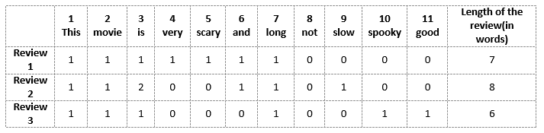
Bag of Word (BoW) Model
Simplest form of text representation in numbers
Represent a sentence as a bag of words vector (a string of numbers)
Example:
  Review 1: This movie is very scary and long
  Review 2: This movie is not scary and is slow
  Review 3: This movie is spooky and good
Build a vocabulary from all the unique words in the above three reviews. The vocabulary consists of these 11 words: ‘This’, ‘movie’, ‘is’, ‘very’, ‘scary’, ‘and’, ‘long’, ‘not’, ‘slow’, ‘spooky’, ‘good’.
We can now take each of these words and mark their occurrence in the three movie reviews above with 1s and 0s. This will give us 3 vectors for 3 reviews:
Vector of Review 1: [1 1 1 1 1 1 1 0 0 0 0]
Vector of Review 2: [1 1 2 0 0 1 1 0 1 0 0]
Vector of Review 3: [1 1 1 0 0 0 1 0 0 1 1]

Slide 12
Drawbacks of using a Bag-of-Words (BoW) Model
If the new sentences contain new words, then our vocabulary size would increase and thereby, the length of the vectors would increase too.
Additionally, the vectors would also contain many 0s, thereby resulting in a sparse matrix (which is what we would like to avoid)
We are retaining no information on the grammar of the sentences nor on the ordering of the words in the text.

Slide 13

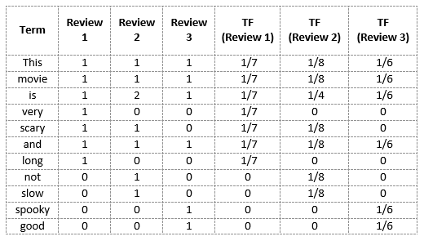
Term Frequency-Inverse Document Frequency (TF-IDF)
“Term frequency–inverse document frequency, is a numerical statistic that is intended to reflect how important a word is to a document in a collection or corpus.”
Term Frequency (TF)
It is a measure of how frequently a term, t, appears in a document, d:
Here, in the numerator, n is the number of times the term “t” appears in the document “d”. Thus, each document and term would have its own TF value.
E.g. Review 2: This movie is not scary and is slow
Here,
Vocabulary: ‘This’, ‘movie’, ‘is’, ‘very’, ‘scary’, ‘and’, ‘long’, ‘not’, ‘slow’, ‘spooky’, ‘good’
Number of words in Review 2 = 8
TF for the word ‘this’ = (number of times ‘this’ appears in review 2)/(number of terms in review 2) = 1/8

Slide 14

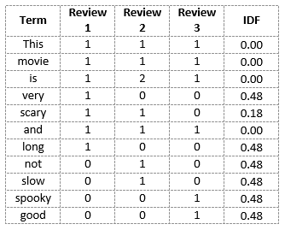
Term Frequency-Inverse Document Frequency (TF-IDF)
Inverse Document Frequency (IDF)
IDF is a measure of how important a term is. We need the IDF value because computing just the TF alone is not sufficient to understand the importance of words:
E.g.
We can calculate the IDF values for the all the words in Review 2:
IDF(‘this’) = log(number of documents/number of documents containing the word ‘this’)
= log(3/3) = log(1) = 0
Hence, we see that words like “is”, “this”, “and”, etc., are reduced to 0 and have little importance; while words like “scary”, “long”, “good”, etc. are words with more importance and thus have a higher value.

Slide 15

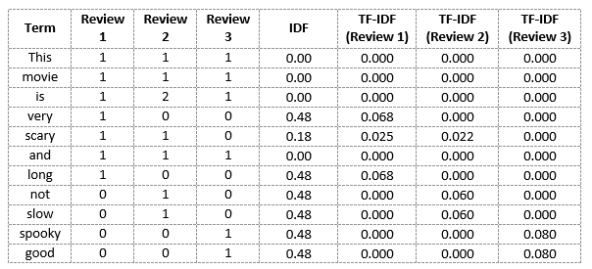
Term Frequency-Inverse Document Frequency (TF-IDF)
We can now compute the TF-IDF score for each word in the corpus. Words with a higher score are more important, and those with a lower score are less important:
Example:
We can now calculate the
TF-IDF score for every word in Review 2:
TF-IDF(‘this’, Review 2) = TF(‘this’, Review 2) * IDF(‘this’) = 1/8 * 0 = 0
TF-IDF also gives larger values for less frequent words and is high when both IDF and TF values are high i.e the word is rare in all the documents combined but frequent in a single document.
While both Bag-of-Words and TF-IDF have been popular in their own regard, there still remained a void where understanding the context of words was concerned. Detecting the similarity between the words ‘spooky’ and ‘scary’, or translating our given documents into another language, requires a lot more information on the documents.

Slide 16
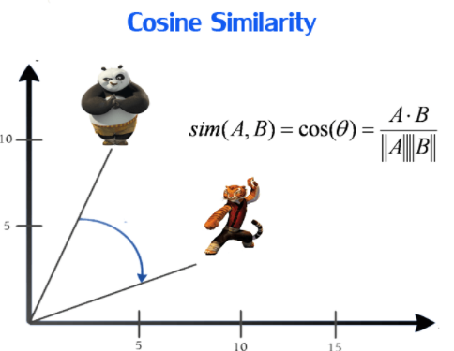
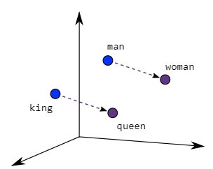
Word2Vec
Word2vec is a two-layer neural net that processes text by “vectorizing” words. Its input is a text corpus and its output is a set of vectors: feature vectors that represent words in that corpus.
The Word2Vec objective function causes the words that have a similar context to have similar embeddings. Thus in this vector space, these words are really close.
Mathematically, the cosine of the angle (Q) between such vectors should be close to 1, i.e. angle close to 0.
As seen in the image below where word embeddings are plotted, similar meaning words are closer in space, indicating their semantic similarity.

Slide 17
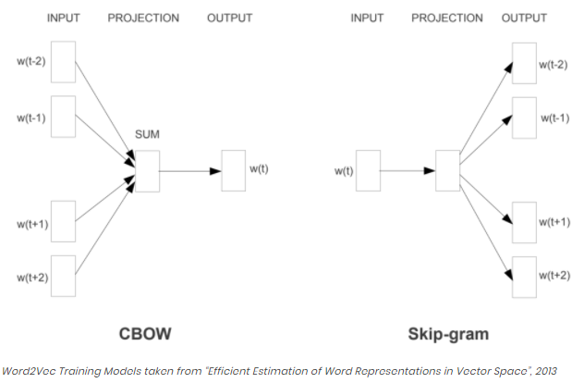
Word2Vec
Two different model architectures that can be used by Word2Vec to create the word embeddings are the Continuous Bag of Words (CBOW) model & the Skip-Gram model.
The CBOW architecture comprises a deep learning classification model in which we take in context words as input, X, and try to predict our target word, Y.
In the skip-gram model, given a target (Centre) word, the context words are predicted.

Slide 18
Intro to Language Modelling
What is Language Modelling?
  Language model in NLP is a model that computes probability of a sentence( sequence of words) or the probability of a next word in a sequence.
Language Model v/s Word Embedding
  Language models, word order matters because it tries to capture the context between words
  Words embeddings, only semantic similarity is captured because it is trained by predicting words in a window regardless of the order.
Application of Language models
  Sentimental Analysis
  Question-Answering
  Summarization
  Machine Translation
  Speech recognition

Slide 19
Language Modelling
Making a Language model
  Using N-grams
  Using Neural Networks
  Using Long Short Term Memory Networks (LSTM)
Evaluation of a Language model
  Perplexity is used to evaluate Language models. It is a measurement of how well a probability model predicts test data.
  Like the word ‘perplexed’, which means puzzled or confused, we measure how confused our model is, low perplexity means coherent/well-made sentences are generated by the model, whereas, high perplexity denotes incoherent and jumbled sentences. Therefore, low perplexity is good and high perplexity is bad.

Slide 20
THANK YOU FOR YOUR
ATTENTATION

